Slide 1
GRAPHICAL ANALYSIS FOR MECHANISMS
Kinematic Solutions
For working out the solution for any given problem the following four sequential steps are:
SPACE DIAGRAM (in space SCALE)
VELOCITY DIAGRAM (in velocity SCALE)
ACCELERATION DIAGRAM (in acceleration SCALE)
RESULTS (in tabular form)

Slide 2
CONVENTIONS AND NOTATIONS FOLLOWED
From the instantaneous Space Diagram and other data Velocity and Acceleration Diagrams are constructed systematically. Convention for notations in the diagrams are as follows:
For Space Diagram Block letter
(For Displacement Diagram Small letter)
For Velocity Diagram Small letter with single dash superscript
For Acceleration Diagram Small letter with double dash superscript
And, in general, vectors are not shown with their usual arrowheads.

Slide 3
The parts of the machine are usually called elements, and two elements which are in contact, and between which there is relative motion, are known as a pair. An element joining two pairs is called a link or bar. If a group of links and pairs is capable of relative motion but can be made rigid by joining any two elements it is called a kinematic chain. If one of the links of a kinematic chain is ‘fixed’ the chain becomes a mechanism, and if a mechanism is used to transmit force it becomes a machine.

Slide 4
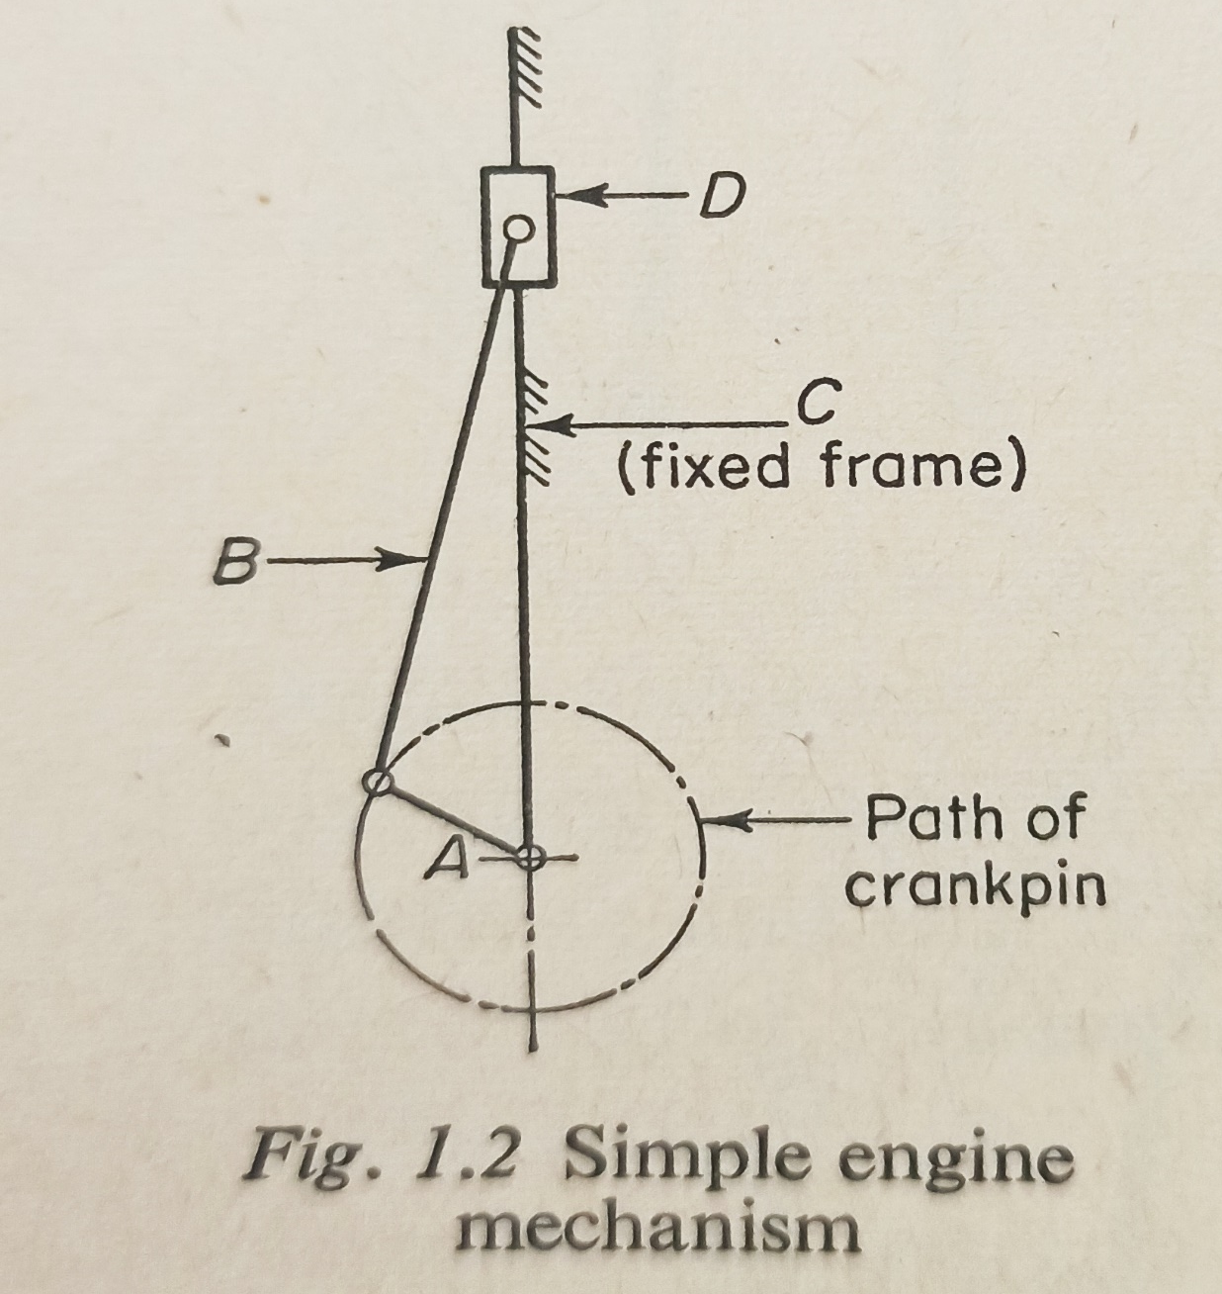
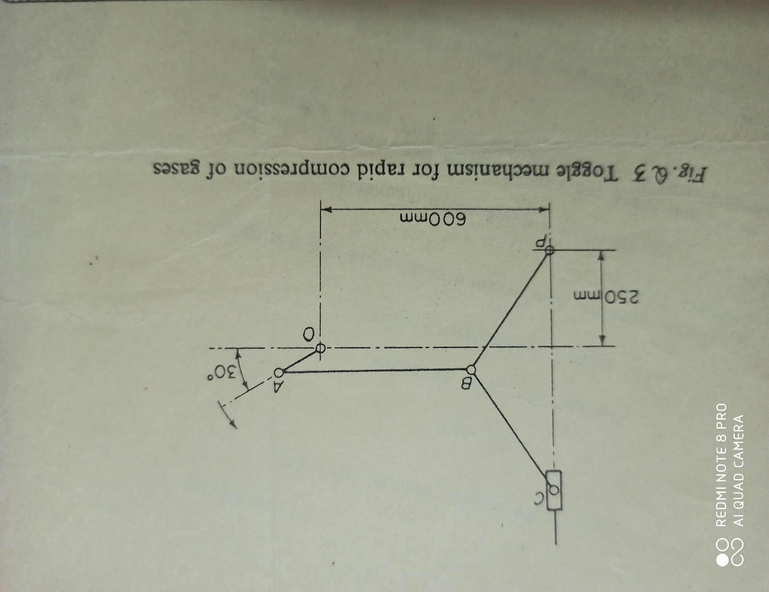
Conventions for representation in SPACE DIAGRAM: links/bar by straight lines; turning pair by a dot or small circle; piston/slider by rectangle over the line representing frame; ‘fixed’ point by vertical cross; ‘fixed’ member by hatching on the frame.

Slide 5
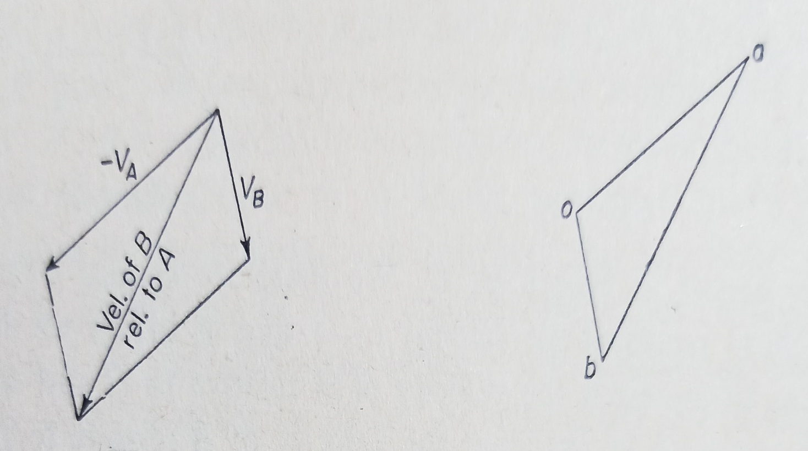
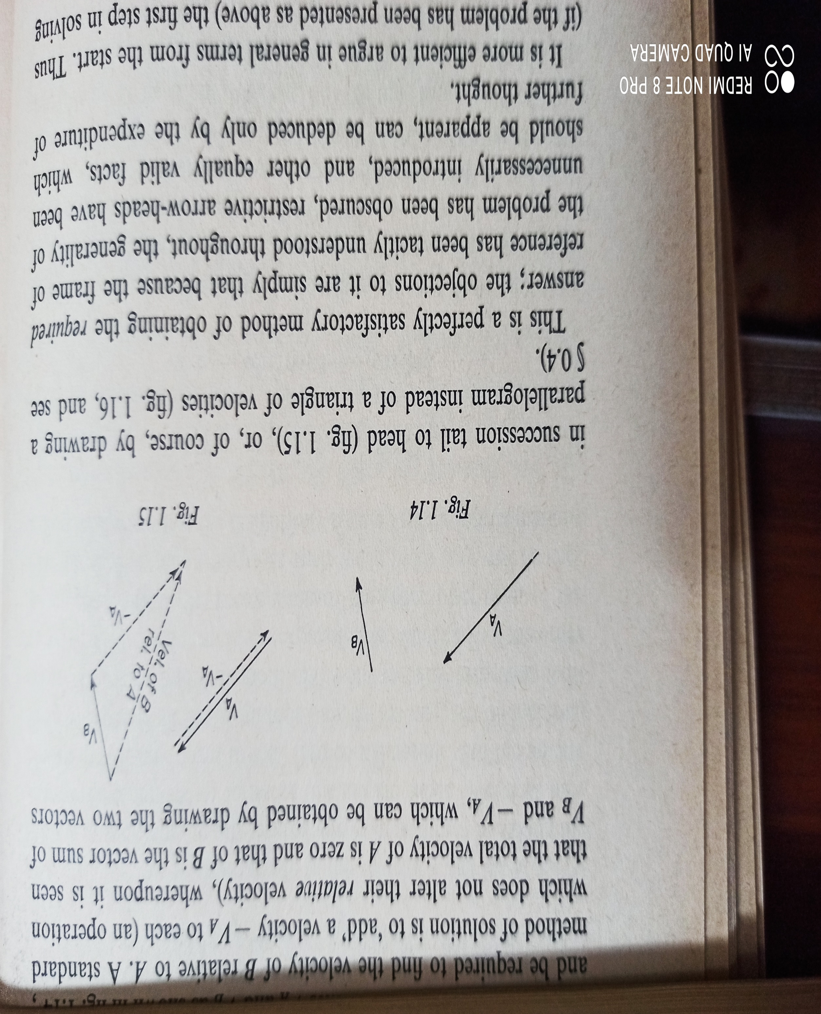
VELOCITY DIAGRAMS

Slide 6
VELOCITY DIAGRAMS
While constructing Velocity Diagrams the ‘rule of thumb’ is: if AB is a rigid link in a mechanism, the line a´b´ in the velocity diagram is perpendicular to it.
Two simple corollaries are:
If ABC is a rigid triangular link in a mechanism, the velocity diagram will contain a similar triangle, a´b´c´, of which each side is perpendicular to the the corresponding side in the Space Diagram of the mechanism.
If ABC are three points on a straight link the velocity diagram will contain a straight line a´b´c such that a´b´: b´c = AB:BC.
These similar figures are often referred to as the ‘velocity images’ of the links.

Slide 7
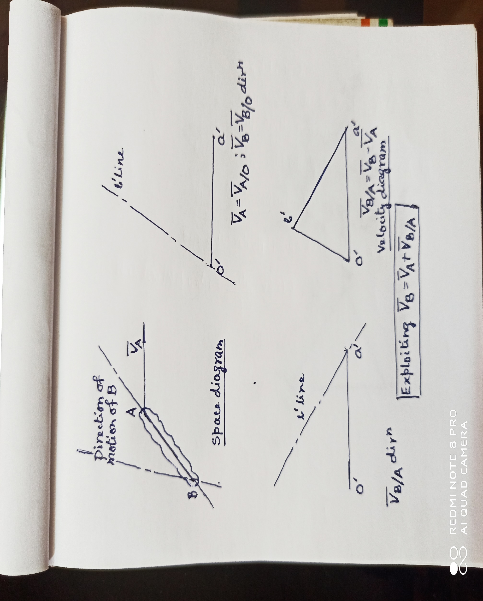

Slide 8
ACCELERATION DIAGRAMS
In general, a particle moving in a curvilinear path will have two components of acceleration: centripetal acceleration and tangential acceleration. Thus the total acceleration of the particle is the vector sum of the above two components.
While constructing Acceleration Diagrams the ‘rule of thumb’ is: if AB is a rigid link in a mechanism and a´b´ is its velocity image the centripetal component of acceleration will be of length (a´b´)²/AB and its direction will be ‘opposite’ to that of the link: the tangential component will be perpendicular to it.
Two corollaries for acceleration diagrams are similar to their velocity counterparts.
If ABC is a rigid triangular link in a mechanism, the accleration diagram will contain a similar triangle a´´b´´c´´.
If ABC are three points on a straight link the acceleration diagram will contain a straight line a´´b´´c´´ such that a´´b´´: b´´c´´ = AB:BC.
These similar figures are often referred to as the ‘acceleration images’ of the links.

Slide 9
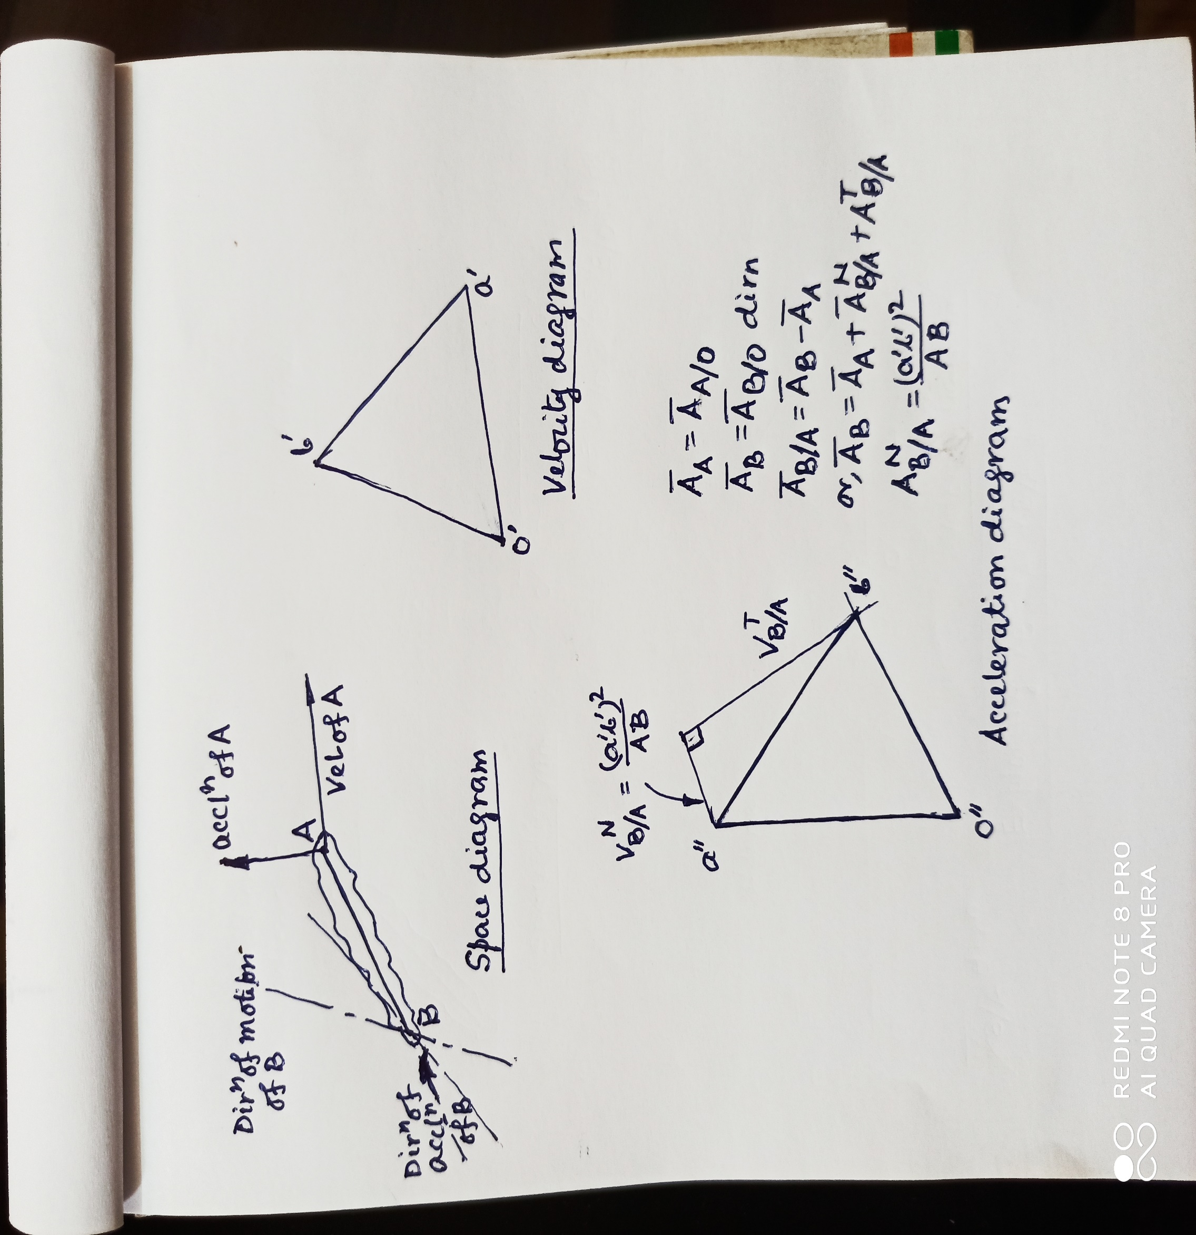

Slide 10
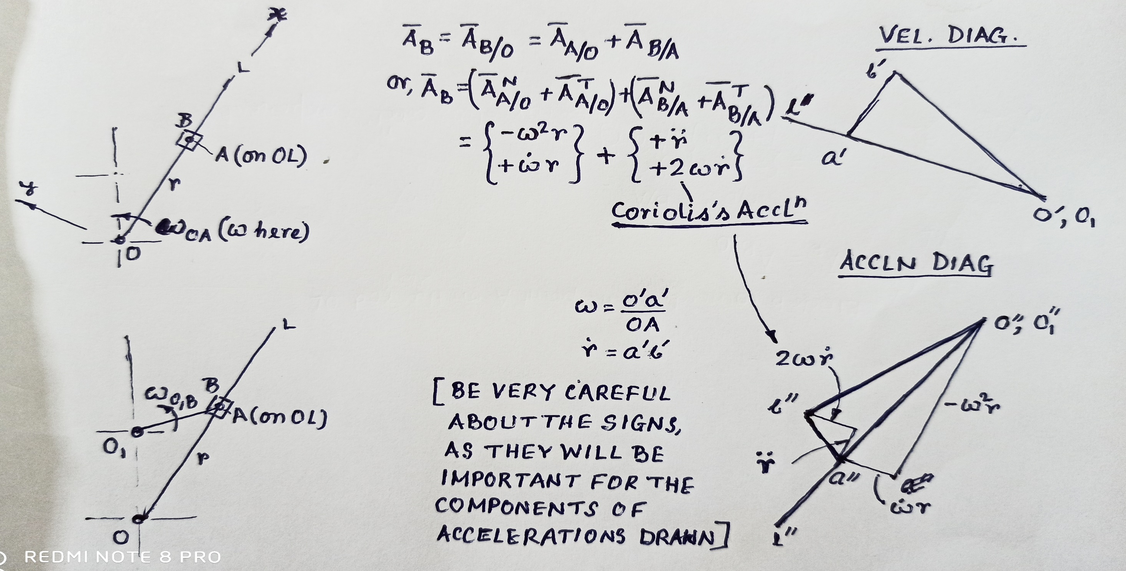
CORIOLIS’S ACCELERATION

